Slide 1
Time Series
Denzel See P2222840 DAAA2A07

Slide 2
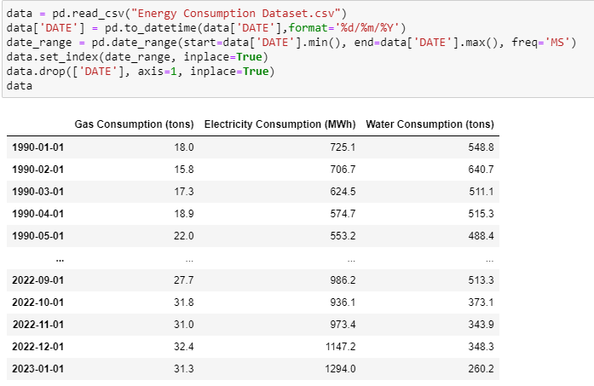
Data Import + PRocessing
I had to initialize the frequency of the data time column in the time series

Slide 3
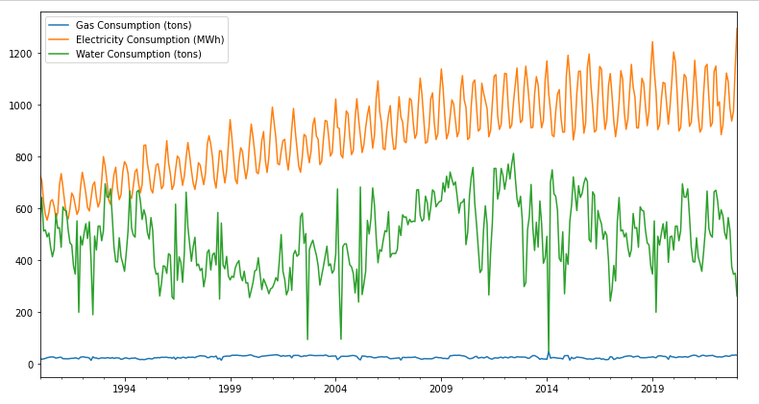
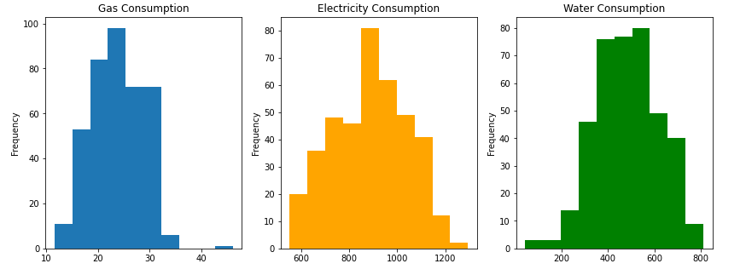
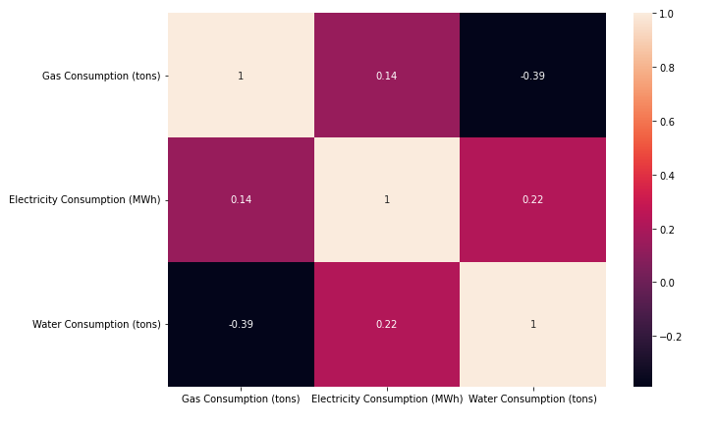
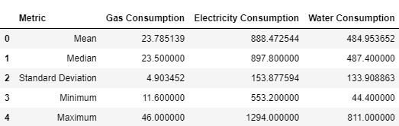
Data Visualization
I plotted the data with different graphs to understand the data better

Slide 4
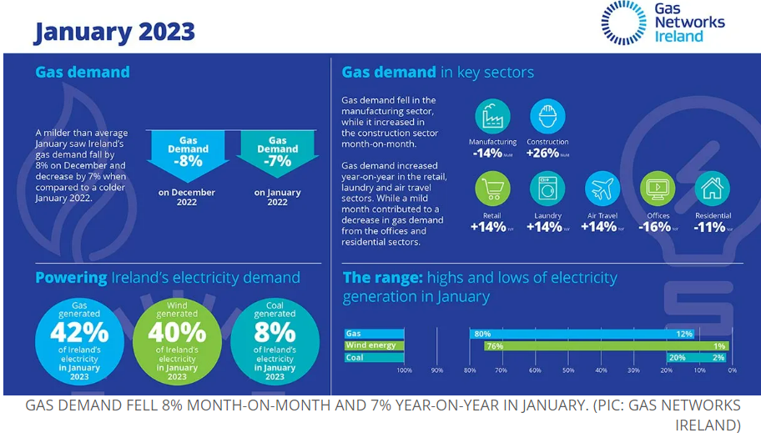
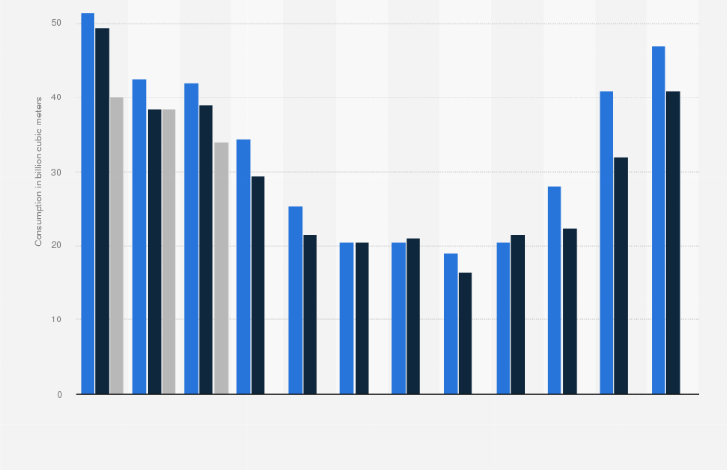
Background Research
Gas Consumption
I found a website that showed a graph of EU monthly gas consumption and another article which talked about tells me why the data has that trend

Slide 5
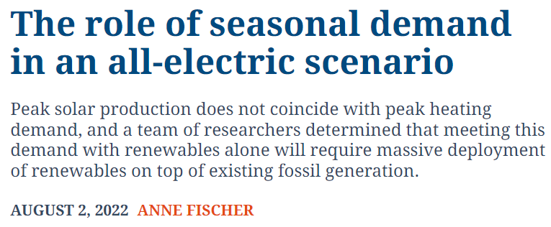
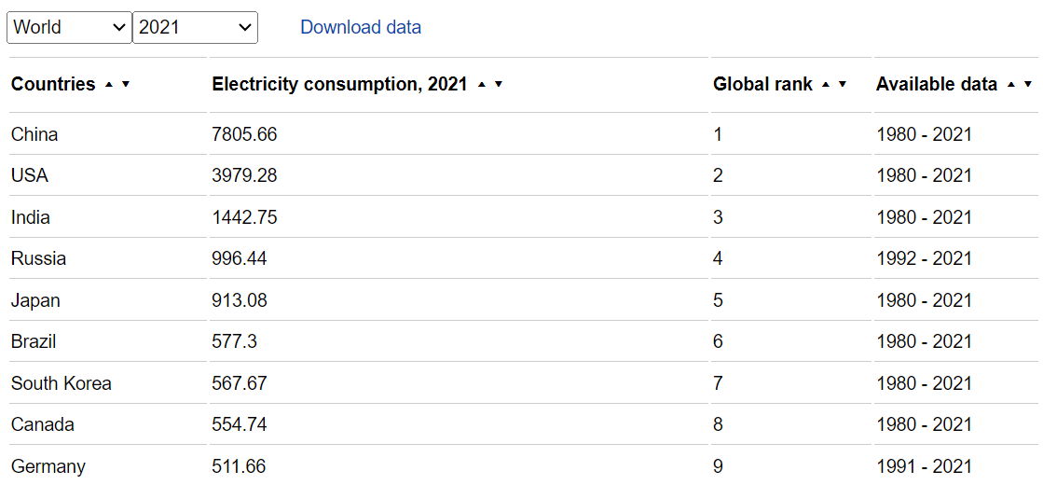
Background Research
Electricity Consumption
I found a website that talked about the seasonal trends of electricity consumption and found the yearly electricity consumption of countries

Slide 6

Background Research
Water Consumption
I found a website that talked about the seasonal trends of water consumption, saying that it peaks in August and dips in December

Slide 7
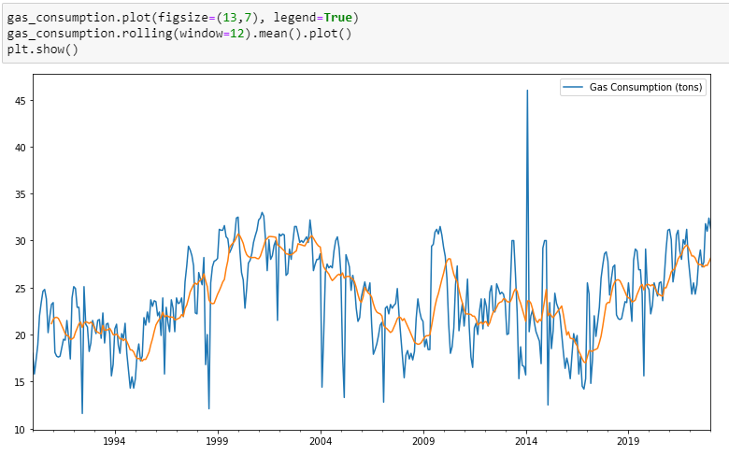
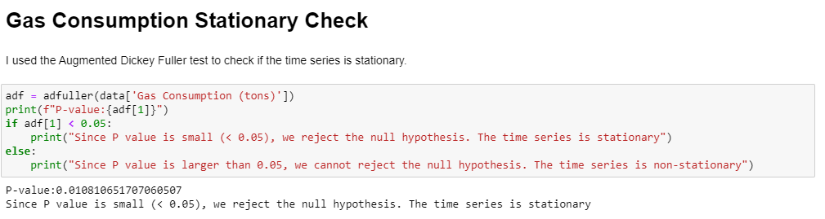
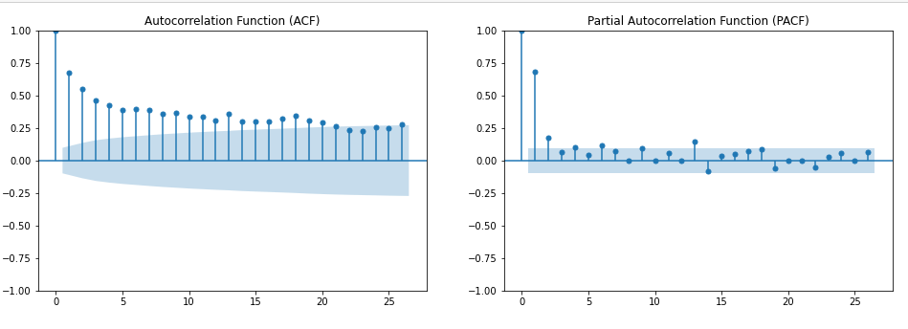
Gas Consumption
I used moving average to get the general trend of the plot, checked if data was stationary and plotted the ACF and PACF to see if data has seasonality.

Slide 8
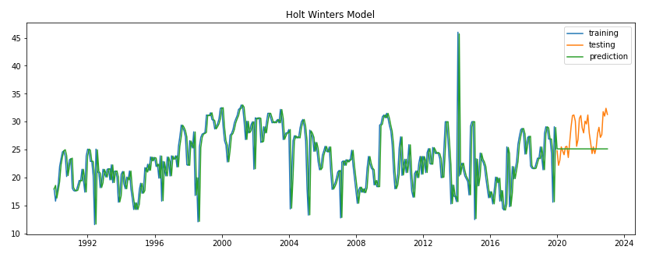
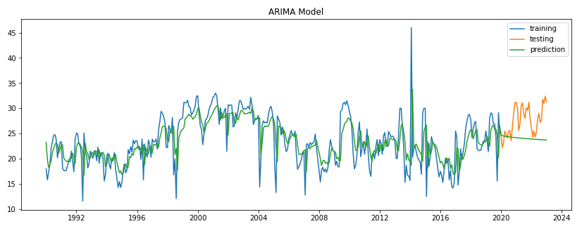
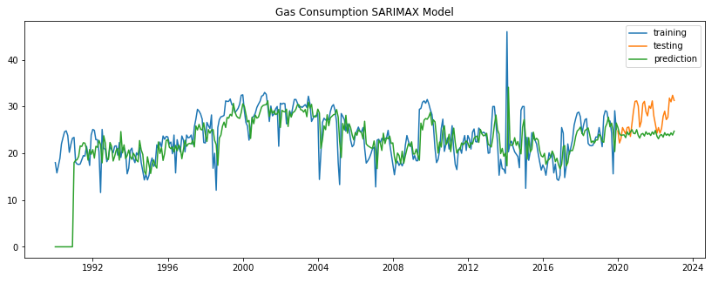
Gas Consumption
Holt Winters
ARIMA
I plotted Holt Winters Linear Exponential Smoothing, ARIMA and SARIMA for Gas Consumption
SARIMA

Slide 9
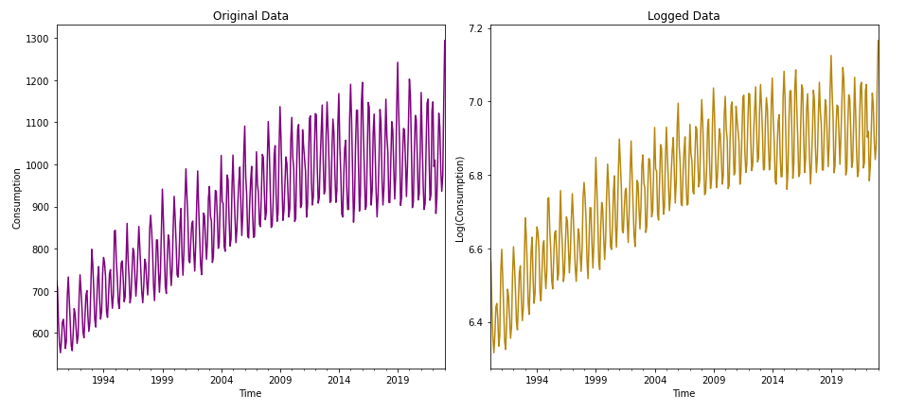
Electricity Consumption
For electricity, after plotting the graph, I can tell that the time series is multiplicative since the amplitude of season increases with the trend.
Thus, I decided to log to time series so that it becomes an additive time series

Slide 10
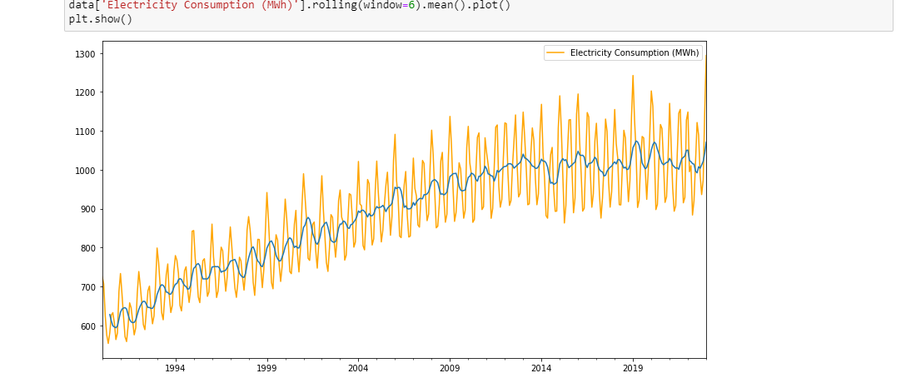
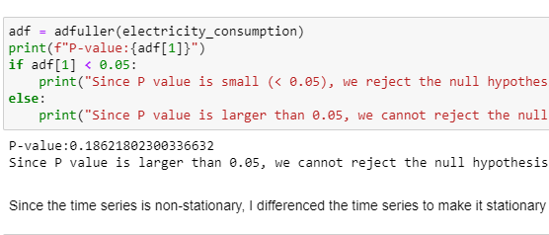
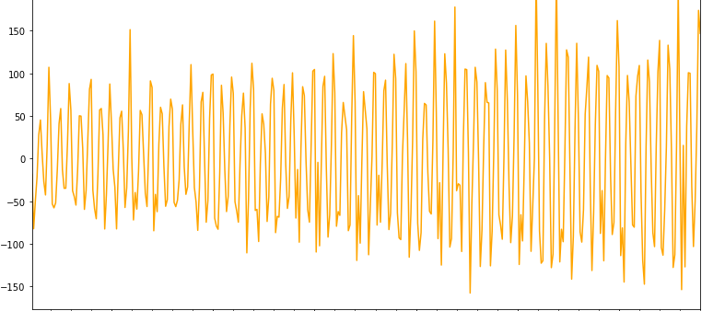
Electricity Consumption stationary
My time series for electricity consumption was not stationary so I had to differentiate it. After differentiating, the data was finally stationary
After I logged the data, the data becomes stationary

Slide 11
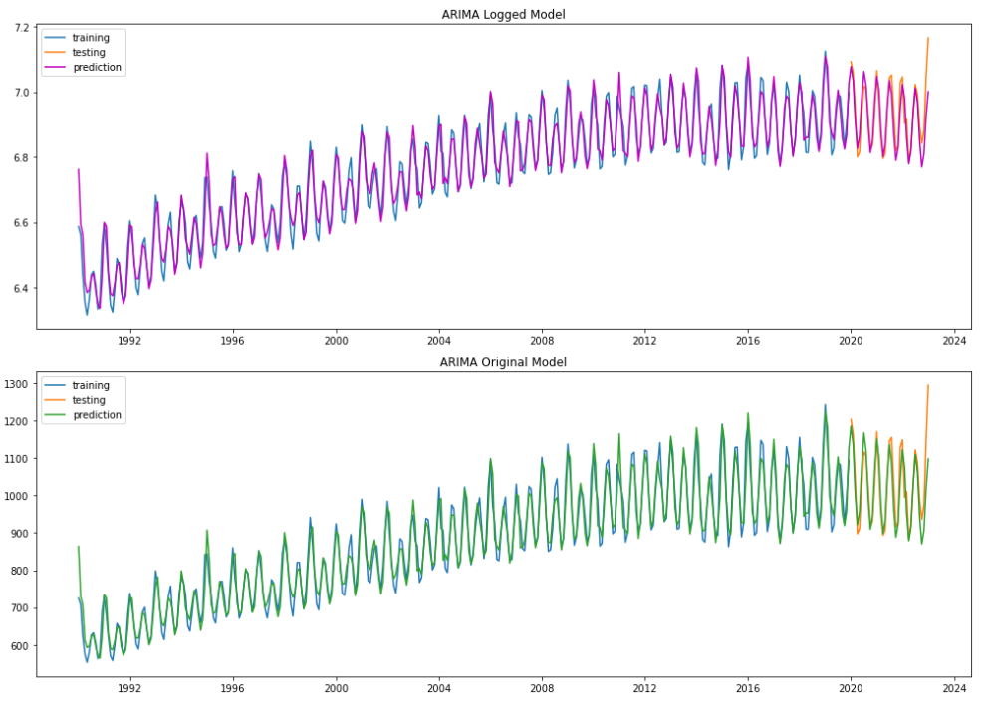
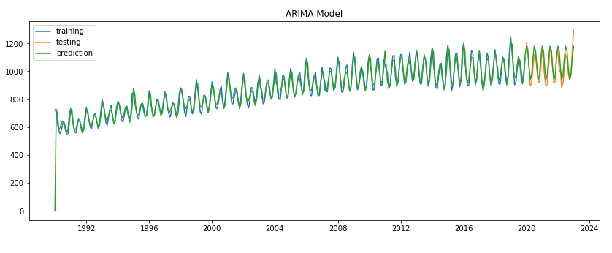
Logged vs Original (ARIMA)
Logged
My logged ARIMA has a MAPE of 3.71% while my Original ARIMA has a MAPE of 4.45%
Original

Slide 12
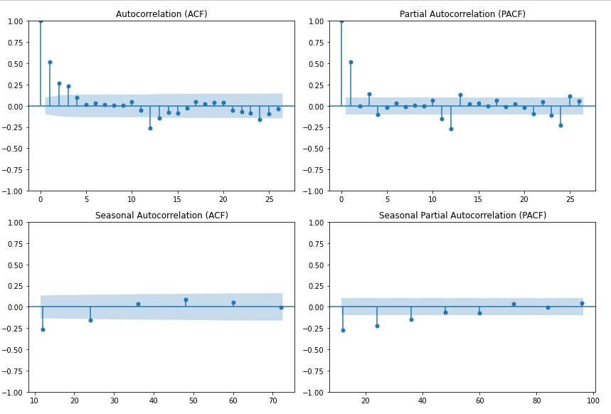
Seasonal ACF and PACF
I plotted the seasonal ACF and PACF by using the data.diff(12) where 12 is my seasonal period.

Slide 13
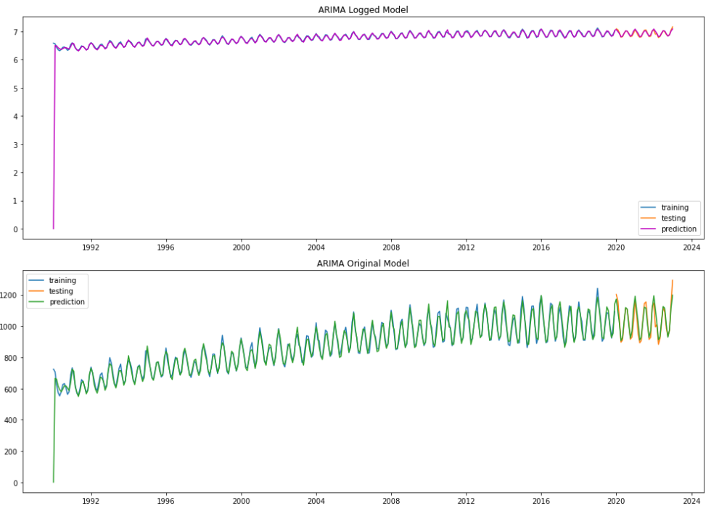
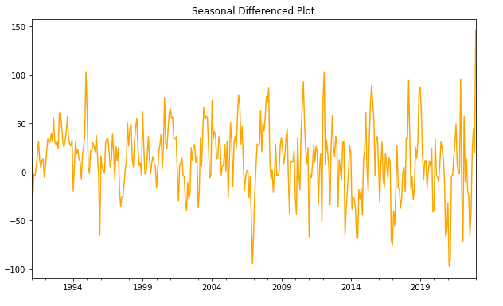
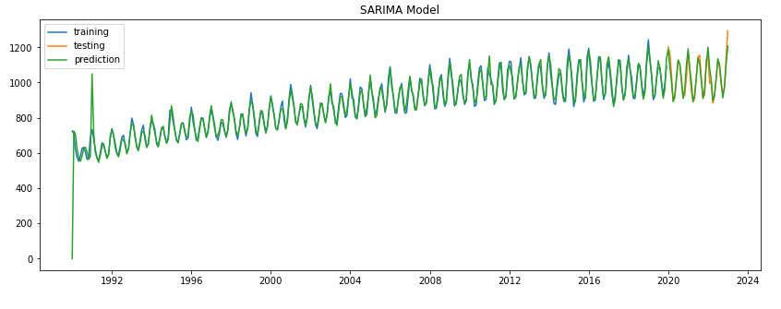
Logged vs Original SARIMA
Logged
My logged SARIMA has a MAPE of 2.69% while my Original SARIMA has a MAPE of 2.37%
Original

Slide 14
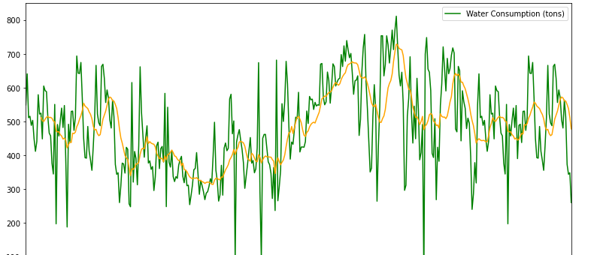
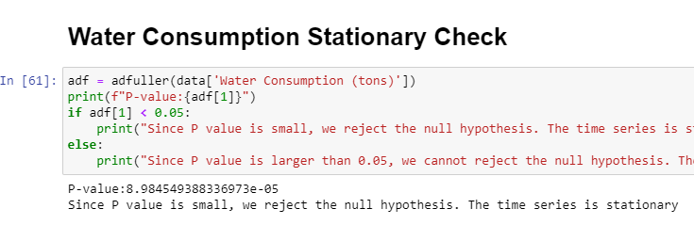
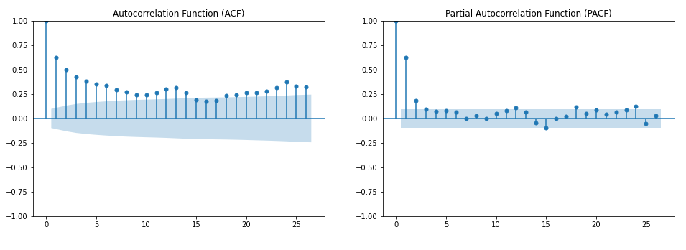
Water Consumption
Just like Gas, I plotted the graph with moving average to see the general trend. Then I check if the data is stationary and plotted the ACF and PACF to see if data has seasonality.

Slide 15
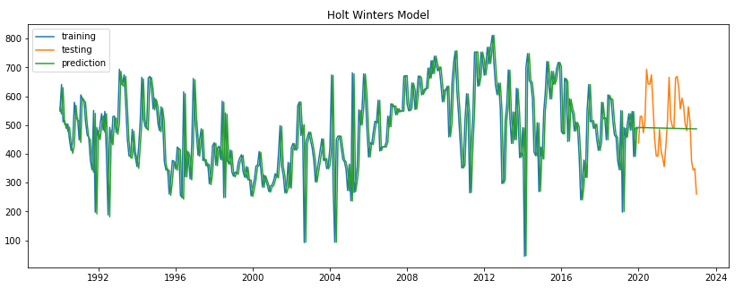
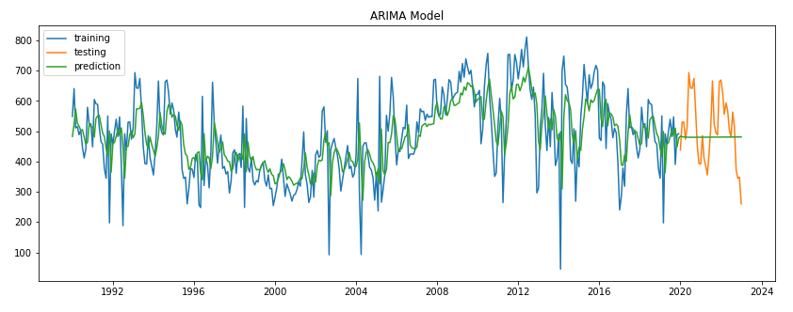
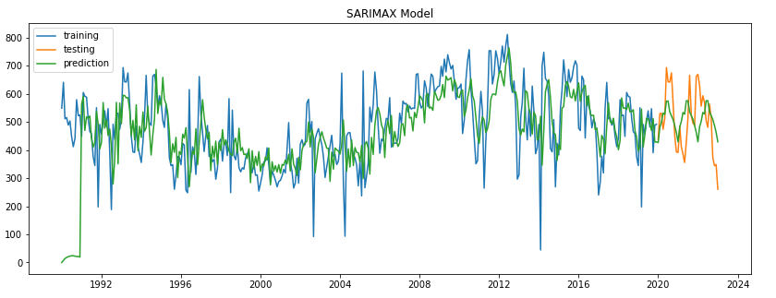
Water Consumption
Holt Winters
ARIMA
I plotted Holt Winters Linear Exponential Smoothing, ARIMA and SARIMA for Gas Consumption
SARIMA

Slide 16
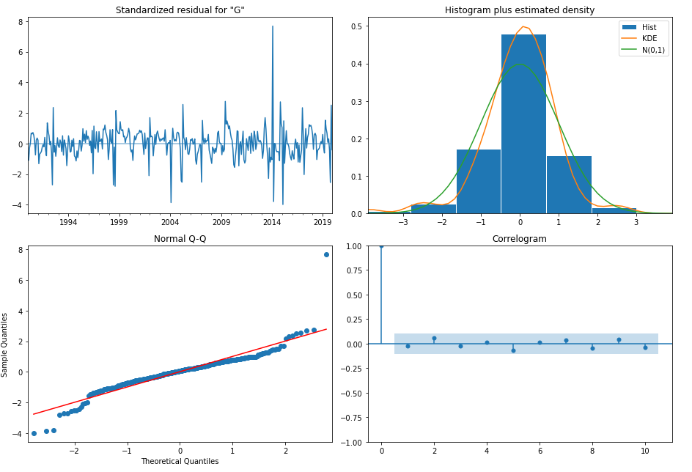
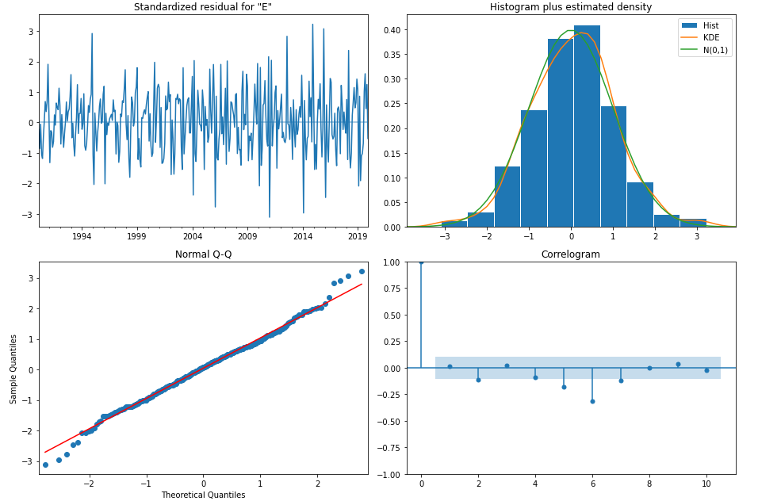
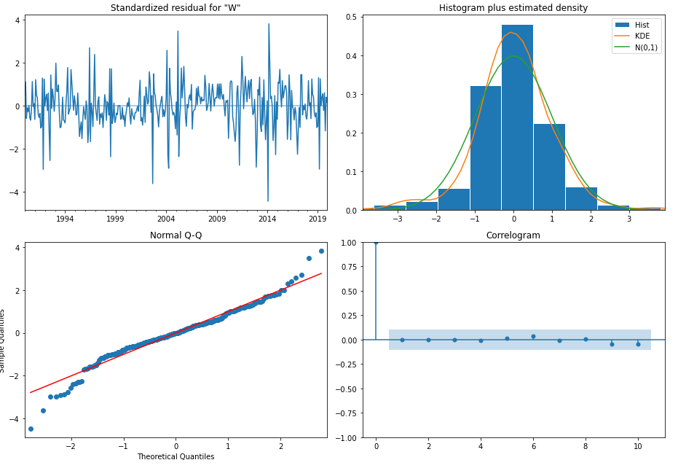
Diagnostic Model (ARIMA)
Gas Consumption
This is the diagnostic models for ARIMA for all 3 consumptions
For Electricity Consumption, the Correlogram has a significant spike thus showing that it isn’t a good fit.
Electricity Consumption
Water Consumption

Slide 17
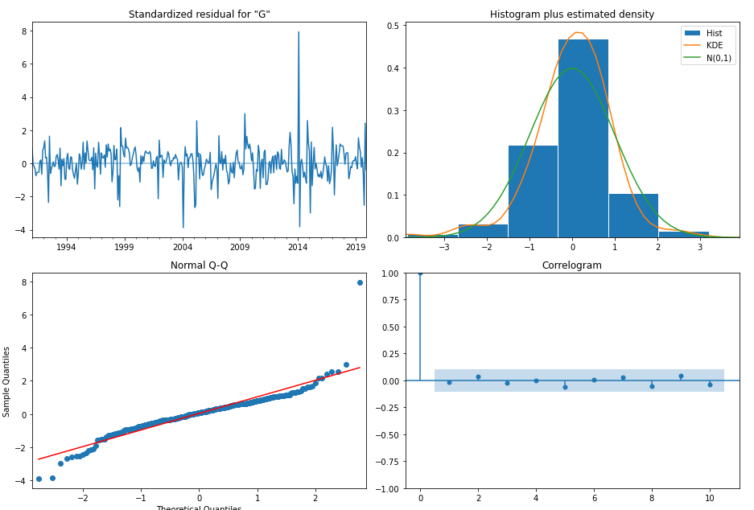
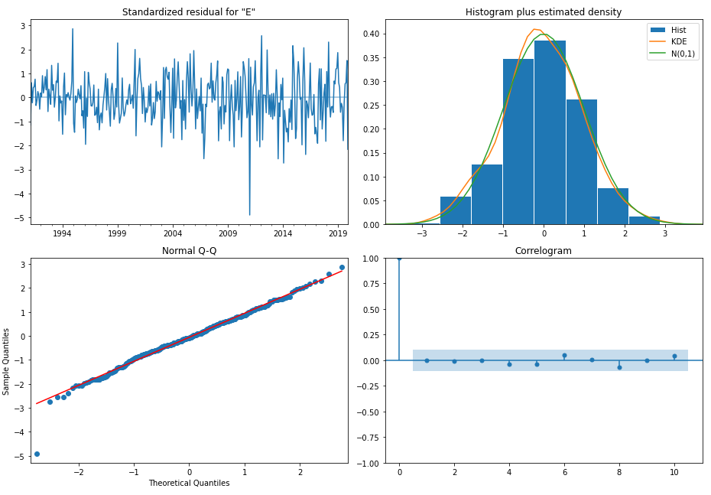
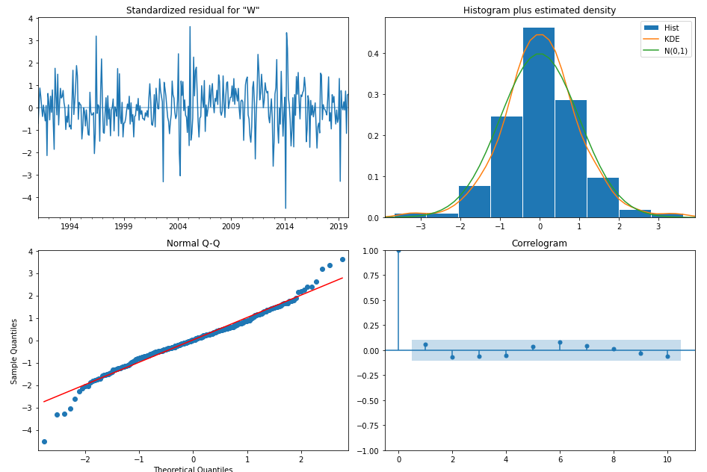
Diagnostic Model (SARIMA)
Gas Consumption
This is the diagnostic models for SARIMA for all 3 consumptions
All three models have a good fit
Electricity Consumption
Water Consumption

Slide 18
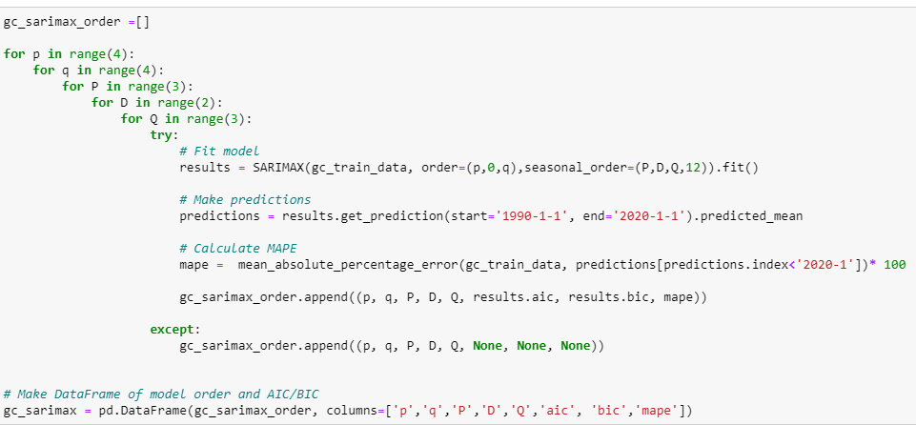
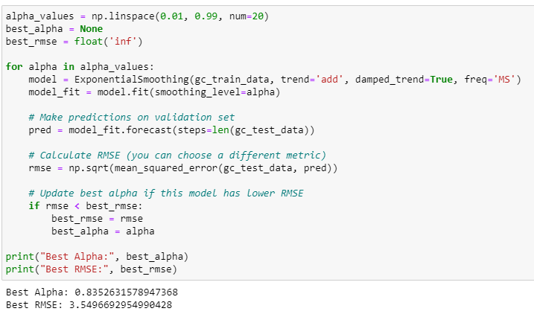
Model Optimization
I used for loops to do a ‘manual’ GridSearch by looping through all the values and finding the best parameters. For ARIMA and SARIMA, I did this because the ACF and PACF is not reliable

Slide 19




ARIMA VS SARIMA
Gas Consumption
Electricity Consumption
Logged Electricity Consumption
Water Consumption

Slide 20
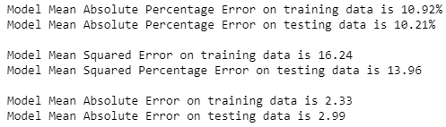
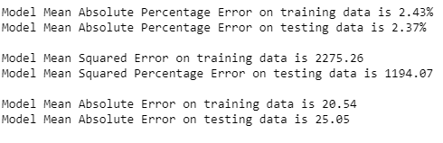
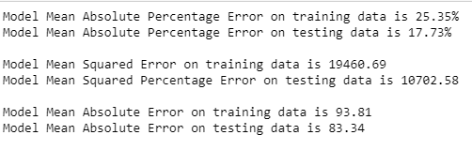
Best Models Overall
Overall, SARIMA for the non-logged electricity consumption data
Overall, SARIMA was the best model for Water Consumption
Overall, Holt winters was the best model for Gas Consumption

Slide 21
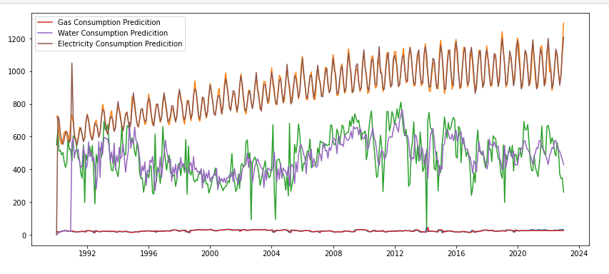
Final Model

